Slide 1
Nonprofit Financial Management Fundamentals
Presented by Hawkins Ash CPAs

Slide 2
10 | Offices | 24 | Partners | $29M | Net Revenue | 63+ | CPAs
Founded | 1956 | 180+ | Employees | 10,000+ | Clients

Slide 4
What we will cover today
Recording Contribution and Grant Revenue
In-Kind Contributions
Functional Expense Reporting
Board Member Responsibilities
Leases Under ASC 842

Slide 5
Recording Contribution and Grant Revenue

Slide 6
Presenters
Briana Peters
CPA
Partner
Brittany Leonard
CPA
Partner

Slide 7
What is a Contribution?
An unconditional transfer of cash or other assets, as well as unconditional promises to give, to an entity, or a reduction, settlement, or cancellation of its liabilities in a voluntary transfer by another entity acting other than as an owner.
Contributions can come in many forms including cash gifts from a donor, gifts of marketable securities, grants, awards, memberships, or sponsorships. Exchange transactions and contributions often get misclassified.

Slide 8
Difference Between a Contribution and an Exchange Transaction
Why do we care?
Recognition is different which is why it is important to segregate one from the other
ASC 606 – exchange transactions
ASC 958 – contributions
Notes:
Typical Example: Exchanges of goods or services (of equal value) would represent commensurate value
A benefit received by the public as a result of the assets being transferred is not equivalent to commensurate value
Execution of an organization’s mission does not constitute commensurate value

Slide 9
Difference Between a Contribution and an Exchange Transaction
How do I determine the difference?
Review the underlying substance of the transaction
Determine if “commensurate value” exists
Commensurate value = equal value flowing between two parties of an agreement
If direct commensurate value is received a transaction, it should be accounted for as an exchange transaction.
If no direct commensurate value a transaction, it should be accounted for as a contribution.
Notes:
Typical Example: Exchanges of goods or services (of equal value) would represent commensurate value
A benefit received by the public as a result of the assets being transferred is not equivalent to commensurate value
Execution of an organization’s mission does not constitute commensurate value

Slide 10
Examples
Example #1:
A student is enrolled at a University. The student’s tuition charged for the semester is $30,000. The student received a grant in the amount of $2,000 paid directly to the University to be used towards tuition. The transaction between the student and the University is an exchange transaction due to the presence of direct commensurate value, and the grant payment of $2,000 serves as a partial payment against the total amount owed, therefore, this would be accounted for as an exchange transaction.
Example #2:
An NFP Organization receives a federal grant to offer educational programs to children ages 0-5. Students meeting certain income requirements may apply to the program. This exemplifies a benefit to the general public where no direct commensurate value is being received, therefore, this would be accounted for as a contribution.

Slide 11
Memberships
Memberships can be exchange transactions, contributions, or a combination of both.
The term “members” can be used broadly by some NFPs to refer to their donors.
In certain cases members may pay dues to an NFP which in turn may or may not directly benefit them in some way. It’s important to take a look at the membership benefits being received to determine if commensurate value exists.

Slide 12
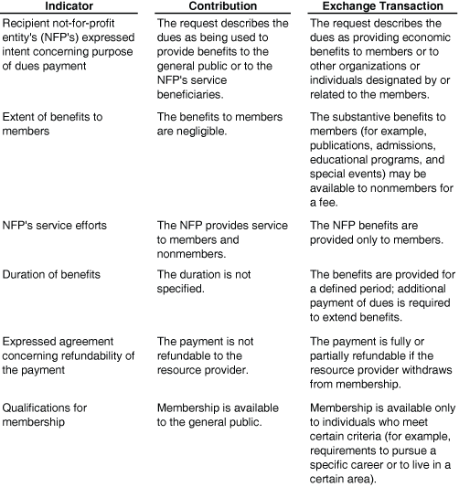
Memberships

Slide 13
Memberships Contributions
Common indicators of membership dues that would qualify as contributions:
Dues are being used to provide benefits to the general public or to the NFP’s service beneficiaries
Benefits to members are insignificant
NFP provides service to members and non-members
Duration of the membership benefits are not specified
Payment is not refundable
Membership is available to the general public

Slide 14
Memberships Exchange Transactions
Common indicators of membership dues that would qualify as exchange transactions:
Dues are being used to provide benefits to members or to other entities or individuals related to members
Members benefits (for example publications, admissions, educational programs, and special events) may be available to nonmembers for a fee
NFP benefits are provided only to members
Duration of the membership benefits is specified
Payment is refundable if membership is withdrawn
Membership is available to individuals who meet certain criteria

Slide 15
Conditional Contributions
After it is determined you have a contribution, the transaction should be assessed to determine whether any conditions exist. Two things need to exist for the grant to be considered conditional:
There is a barrier the nonprofit must overcome to be entitled to the resources, and
The contributor retains a right of return for the resources provided

Slide 16
Barrier
The existence of a barrier is subject to judgment, possible indicators of a barrier are:
A measurable barrier
Limited discretion in the conduct of an activity
Requirements related to the purpose of the agreement
Notes:
A measurable barrier: This might be performance-related. One example would be a grant to assist a food shelter where they are required to provide 1,000 meals per month. Another example would be a requirement that a matching amount of contributions would need to be obtained by an organization.
Limited discretion in the conduct of an activity: The agreement might place a limit to the discretion in how the activity may be conducted. An example would be a grant that can only be spent on costs incurred to prevent and respond to the coronavirus pandemic.
Requirements related to the purpose of the agreement: Examples might be an agreement that requires a homeless shelter to construct a building addition with a specific amount of sleeping capacity.
Stipulations that are administrative or trivial would not constitute a barrier. Reporting on the project would not be a stipulation creating a barrier.

Slide 17
Revenue Recognition
The revenue recognition for an unconditional contribution is simple – recognized at the time the contribution is made or received.
Conditional contributions would be recognized once the conditions are met. One exception to this is if cash or other assets were received in advance. If this is the case, the assets received would be recorded as a refundable advance liability until all of the conditions were met.
If you require audited financial statements, conditional contributions require disclosure in your financial statements

Slide 18
Unconditional Promises to Give
Often donors will make a promise of a future gift to an Organization referred to as a “promise to give”
Most commonly seen in capital campaigns
If unconditional, these promises to give should be recognized when they are received (if sufficient evidence exists in the form of verifiable documentation that a promise was made and received)
If expected to be received in greater than 12 months, present value techniques should be used to determine the fair value of the pledge

Slide 19
Restricted Contributions
Contributions can only be restricted by donors
Board members and management can not restrict donations – board designated
Restricted contributions can have a purpose restriction or time restriction
Documentation
Donor communication/check stubs – keep as evidence of restrictions
Expenses and fixed asset purchases - keep as evidence of fulfilling restrictions

Slide 20
Tracking Restricted Contributions
Need to ensure donor wishes are being met
Ways to track restrictions/spending:
Creating classes or projects in your software
Excel spreadsheets
Don’t net the revenue and expenses – need separate GL accounts
Don’t create one account for the spending – need to still break out spending by proper expense accounts

Slide 21
Capital Campaign Considerations
Ensure accounting and development are working together.
Have documentation for all pledges.
Make sure campaign budget is clear so donors know what their funds are being used on.
Have a system in place to track donations as well as the spending of those donations.

Slide 22
Stock Donation Accounting
Recorded as a contribution at fair market value on the date of receipt.
If subsequently sold, report the difference in sale price and contribution amount as investment income.
Generally if sold immediately, there will be an immaterial difference.
If stock is held for a length of time before sold, could result in significant difference.
Reminder: When thanking donor for a gift of stock, do not list the value of the stock. Only list the number of shares and name of stock.

Slide 23
Year End Donation Accounting
Develop a process to track year end donations to ensure they are recorded in the correct period.
Donations should be recorded when received or pledged, not based on the check date.
Year end cutoff guidelines for various donation methods:
In person – date physically received by the organization.
Mailed – date received by the organization. If not able to check mail around year end, use postmark date as guideline.
Credit card – when fully processed (approved by card issuer).

Slide 24
In-kind Contributions

Slide 25
Presenter
Emily Donohue
CPA
Manager

Slide 26
In-Kind Contributions
Donations of non-financial assets, including goods and services.
Include fixed assets (land, buildings, equipment), use of fixed assets or utilities, materials and supplies, intangible assets, services, and unconditional promises of those assets.

Slide 27
Contributed Services Definition
Recognize contributed services if services provided:
Create or enhance nonfinancial assets
Require and are provided by individuals possessing specialized skills
Services would typically need to be purchased if not donated
Examples: Accountants, lawyers, teachers, etc.
Volunteer time is not recorded as in-kind service contributions because it does not meet the requirements above.

Slide 28
Valuation of In-Kind Contributions
Valued at fair value on the date contribution is received.
Fair Value is the price that would be received to sell an asset or paid to transfer a liability in an orderly transaction between market participants at the measurement date.
Donation of fundraising items (i.e. auction items) are valued using the final amount received from the sale or raffle of the item.

Slide 29
Examples of Gifts-in-Kind (GIK)
Contributed advertisement and radio time
Contributed use of facilities, utilities
Contributed personnel costs from an affiliate
Contributions for fundraisers
Contributed administration costs
Contributed collection items
Below-market interest rates

Slide 30
ASU 2020-07 Presentation and Disclosures by Not-for-Profit Entities for Contributed Nonfinancial Assets
Effective for annual reporting periods beginning after June 15, 2021
Increases transparency about contributed nonfinancial assets through enhancements to presentation and disclosure
Impacts reporting of in-kind goods and services contributions

Slide 31
ASU 2020-07 Requirements Statement of Activities
Present contributed nonfinancial assets as separate line items in the statement of activities

Slide 32
ASU 2020-07 Requirements Disclosures
Disclose in-kind contributions by category of nonfinancial asset
For each category of nonfinancial asset, disclose:
Information about whether the contributed gifts in-kind (GIK) were monetized or utilized during the reporting period. If they were utilized, a description of the programs or activities in which they were used.
The Organization’s policy about monetizing rather than utilizing GIK (if applicable).
Description of any donor-imposed restrictions associated with the GIK.
Valuation techniques and inputs used to arrive at a fair value measurement.
The principal or most advantageous market used to obtain fair value measurements if it is a market in which the recipient organization is prohibited by donor-imposed restriction from selling or using the contributed GIK.

Slide 33
Disclosure Example
Contributions by category - The value of donated goods and services included as in-kind contributions in the financial statements and the corresponding expenses or assets are as follows for the years ended December 31:
2022 2021
Contributed services $ - $ -
Supplies - -
Rent - -
TOTAL IN-KIND CONTRIBUTIONS $ - $ -
Policy about monetizing or utilizing GIK - The Organization's policy related to gifts-in-kind is to utilize the assets given to carry out the mission of the Organization. If an asset is provided that does not allow the Organization to utilize it in its normal course of business, the asset will be sold at its fair market value as determined by appraisal or specialist depending on the type of asset.
Fair Value determination for contributed services - Contributed services are recognized as in-kind revenues at their estimated fair value if they create or enhance nonfinancial assets or they require specialized skills that would need to be purchased if they were not donated. The Organization receives contributed professional services that are reported using current rates for similar types of services. The Organization also receives a significant amount of donated services from unpaid volunteers who assist in fundraising and special projects. No amounts have been recognized in the statements of activities for these fundraising and special projects services because the criteria for recognition have not been satisfied.
Fair Value determination for contributed supplies - Contributed supplies received by the Organization are recorded as in-kind contribution revenue with a corresponding increase to supplies expense. Donated goods are valued at the wholesale prices that would be received for selling similar products.
Fair Value determination for contributed rent - The Organization entered into a lease agreement for program and office space for which the rental payments stated in the agreement are less than the amount that would be charged for similar space that is rented under similar terms. Using publicly available commercial real estate rental listings, the Organization estimates the rental payments to be half of market price. The amount of contributed rent over the remaining lease term is reported as contributions receivable in the accompanying statements of financial position, and the related rent expense is recorded straight line over the life of the lease in the accompanying statements of activities.
Whether GIK were used or sold during the reporting period - All contributed services, supplies, and rent were utilized by the Organization’s programs and supporting services. There were no donor-imposed restrictions associated with the donated services and assets.

Slide 34
Functional Expense Reporting

Slide 35
Presenter
Sandy Jensen
CPA
Partner

Slide 36
Why Are They Important?
Functional expense schedules are required:
GAAP Financial Statements
Federal Form 990, Part IX [only required for 501(c)3 and 501(c)4 Organizations]
State Reporting Forms – Required for both MN and WI
Can provide a realistic picture of the cost of different programs
Notes:
ASU 2016-14 requires a functional expenses schedule be shown either on the face of the financials( as a stmt) or as a footnote – Before this standard- functional expenses disclosure was voluntary except for Voluntary health and welfare orgs.
Federal Form 990 part IX should mirror the functional expense statement in the financials
Functional expenses are
critical when working to stretch limited resources, or making decisions to expand or discontinue a program
Can be used to analyze overall expenses – too much program – under-investing in technology, personnel and development etc, - too little program – efficiency issues
Can give information about cost of program in order to make decisions

Slide 37
Natural vs. Functional Classifications
Natural Classification
Grouping expenses according to the what type of expense
Is this a Salary expense or is this a Postage expense?
Functional Classification
Grouping expenses according to how/where the expense is utilized within the organization
Is this a cost for Program Activities, Supporting Services, or both?
Notes:
Natural expenses : what kind of expense is this? A little more straight-forward- advertising, utilities, rent etc
Functional expenses – group expenses as to how or where they are used in the Organization – can the expense be linked to one program or activity or is the expense shared by many activities?

Slide 38
Presentation in GAAP Financial Statements
Typically shown as a separate statement, though it can also be shown on the face of the Statement of Activities or in the Notes to the Financial Statements
Notes:
Point out the Natural Classification (horizontal Rows) and Functional Classification (vertical Columns)

Slide 39
Definitions
Program Activities
Activities carried out to fulfill an organization’s mission or purpose and are the major purpose for, and output of, the organization.
Can think of this in total or by separate programs (Educational Program, Housing Program, Etc)
Supporting Services
Activities other than program activities; expenses that are required to ‘run the business’
Typically relate to:
Management and General
Fundraising
Membership Development
Notes:
Program services- one program is appropriate for smaller organizations , but showing more than one program may be appropriate if your organization has distinct programs, example YMCA- may have a childcare program, fitness program , youth program etc
Disaggregation gives the reader more information and should tell the story of your organzation
Note 1 of FS under nature of the activities should describe each of these individual/ classes of programs
Supporting Services management and general activities are supporting activities that are not directly identifiable with one or more program, fundraising, or membership-development activities.
Examples -

Slide 40
Management and General
Supporting activities that are not directly identifiable with one or more program, fundraising, or membership-development activities.
Examples
Oversight
Billing, collecting fees
Public Relations: annual report, press announcements
Accounting: Record keeping, payroll, budgeting, finance
Human Resources
Notes:
If you didn’t have a mission, you wouldn’t exist. What we need to break out are expenses that are not Mission expenses but in Support of the mission.
Oversight of employees – scheduling staff, handling disputes among personnel
Oversight of programs – analyzing metrics – are we having the impact that we want?

Slide 41
Fundraising Activities
Supporting activities undertaken to induce potential donors to contribute money, securities, services, materials, facilities, other assets, or time
Don’t forget joint costs
Examples
Conducting fundraising campaigns
Maintaining donor mailing lists
Conducting special fundraising events
Preparing/distributing fundraising and informational materials
Notes:
Would be abnormal to have contributions and no fundraising activities
Joint costs – should consider audience content and purpose in order to allocates these costs outside of fundraising- example- Newsletters- if there is a section which asks for donations- must allocate a portion to fundraising – if allocating these costs to program – must be a call to a specific action to accomplish the missions

Slide 42
Membership Development
Supporting activities that include soliciting for prospective members and membership dues, relations and similar activities, includes membership relations.
If no significant benefits are provided to members in exchange for their payments of dues, it is considered fundraising activities
Notes:
Typically we do not see this category very often
Similar to fundraising – except instead of receiving a contributions , the Org receives revenue in an exchange transaction where the purchaser receives something of commensurate value- good example

Slide 43
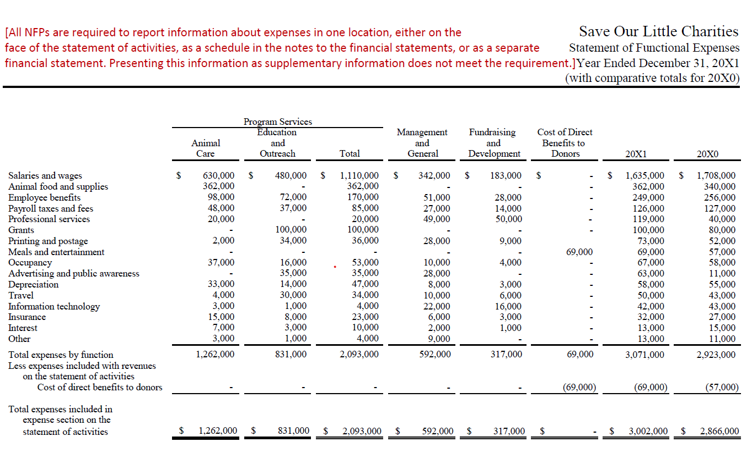
Notes:
Quick presentation point – items other than investment expenses that are netted with revenues such as direct benefits to donors in a special event or a charitable dinner are included in the functional expense schedule and subtracted below to match the amounts reported on the SOA

Slide 44
Allocation of Expenses
‘Reasonable and Consistent’
Methods:
Direct Cost
Square Feet
Employee Time Studies
Notes:
Direct expenses that can be attributed to a specific program or supporting service should be charged to that account
Expenses that relate to more than one program or service should be allocated
The driver for allocation is a matter of judgement and is different for all organizations and can be financial or non financials – common methods are listed above
Can
GAAP ASU – just says that the method needs to be reasonable and consistently applied, so no specific method is required and the method should be disclosed in the financials

Slide 45
Actions to Take
Create an Allocation Methodology Policy
X Method will be used for X Expenses
Y Method will be used for Y Expenses
Responsible Person A will review Method quarterly/annually
New building/reorganization of office – square footage may need to be updated
Staff turnover/restructuring of responsibilities – study of employee time/effort may need to updated
Notes:
written policies – leads to clear expectations and effective communication
Staff Turnover happens, often when we least expect it! Written documents help the onboarding staff.

Slide 46
Board Member Responsibilities

Slide 47
Presenter
Matt
Neu
CPA
Senior Manager

Slide 48
Board Member Responsibilities
Boards have legally mandated fiduciary duties to their organizations. These duties describe the manner in which board members are required to carry out their roles and responsibilities. The fiduciary duties are obedience, care and loyalty.

Slide 49
Board Member Responsibilities
Duty of Obedience: The board must ensure the organization is obedient to its central purposes as described in its articles of incorporation and mission.
Duty of Care: The boards must be knowledgeable of all reasonably available information before taking action, and then act with prudence and care appropriate under the circumstances.
Duty of Loyalty: The board must discharge duties unselfishly, to the benefit of the organization only, and disclose potential conflicts of interest.

Slide 50
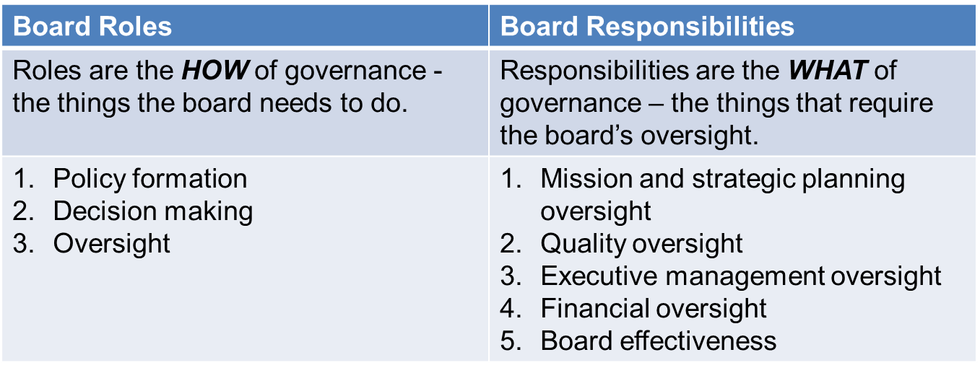
Board Member Responsibilities
Boards have three essential roles and five oversight responsibilities

Slide 51
Board Member Responsibilities
Financial Oversight
The board’s fiduciary responsibility is to protect the organization’s financial status so it can meet its obligations – economic and social – to its communities. Meeting these obligations typically involves a variety of finance-related tasks: budget, investments, capital, fiscal policy, philanthropic opportunities.

Slide 52
Board Member Expectations Internal Control
Board/Finance Committee/Treasurer involvement
Monthly financial statement review and approval
Review of dashboards
Approval of budget
Monthly review of budget to actual reports
Approving expenses over certain threshold and items over budget
Annual risk assessment
Segregation of duties awareness

Slide 53
Policies
Conflict of Interest
Employee Handbook
Credit Card
Whistleblower Protection
Fraud Risk Assessment
Document Destruction and Retention
Cost Allocation
Investment
Board Designated Net Asset
Gift Acceptance
Disaster Recovery Plan for Financial Information
Fixed Asset Capitalization

Slide 54
Leases Under ASC 842

Slide 55
Presenter
Chuck Krueger
CPA
Senior Manager

Slide 56
Prior Guidance – 2 Types of Leases
Capital leases (lessee “owns” the asset and has a liability offset).
Operating leases (lessee ”rents” the asset).
New Standard – Still 2 Types of Leases
Finance leases (capital lease under prior rules)
Still on the statement of financial position (asset and liability).
Operating leases (no change to terminology)
Now also on the statement of financial position (asset and liability). No more “rent” of the asset.

Slide 57
New Guidance Under ASC 842
The new standard is lengthy (around 500 pages) and complex (although most leases will be straightforward with standard process for recording).
You may have a lease even if the contract doesn’t use that terminology.
Key concepts/definitions/questions
Definition of a lease.
What is “reasonably certain”?
How long is the lease term?
Are short term leases treated differently?
Contracts with multiple components.
Finance lease compared to operating lease.
Materiality.

Slide 58
Definition of a Lease
A lease is a contract or part of a contract that conveys the right to control use of an identified asset (property, plant or equipment) for a period of time, in exchange for consideration (generally cash).
Convey control-the lessee must be able to obtain the benefits of use and can direct how the asset is used (it is like they own it).
Period of time might be days/weeks/months or years-does not have be consecutive.
Exchange transaction-cash for use of the asset. Donated rent is considered a contribution-not an exchange. Excluded from lease calculation.

Slide 59
What is “Reasonably Certain”?
This is a factor in deciding if options to extend or terminate a lease should be included in the lease term.
High threshold (think 90% or greater certainty).
Lessee should have a compelling economic reason to exercise a renewal option or NOT to exercise a termination option.
The determination is made at the commencement of the lease.
This concept also is used in the determination of a finance lease.

Slide 60
How Long is the “Lease Term”?
Starts with noncancelable period (both parties legally obligated).
May also include periods by options to extend or not terminate.
Period when lessee is reasonably certain to extend the lease.
Period when lessee is reasonably certain to not terminate.
Periods covered by an option to extend (or not terminate) at the option of the lessor (reasonably certain does not apply).
Are Short Term Leases Treated Differently?-YES
Short term leases are 12 months or less.
Do not contain a purchase option the lessee would exercise.
Short term leases are not subject to ASC 842 guidance.

Slide 61
Contract with Multiple Components
Multiple parts can be treated as separate contracts.
An example would be the right to use a building (lease) and maintenance services for the leased space.
In some cases, could elect to treat as single contract.

Slide 62
Operating or Financing?
Finance lease includes 1 or more of the following:
Transfer of ownership at end of lease.
Lessee can purchase the asset at a price which they are reasonably certain to exercise (under old rules this was a “bargain purchase option”).
Lease term is for a major part (75% or more) of the remaining life of the asset.
The present value of lease payments equals or exceeds 90% of the asset value.
The underlying asset is so specialized there is no alternative use at end of lease.

Slide 63
Materiality is a Factor
Assess leases for materiality. Immaterial leases would not be recorded.

Slide 64
Changes to Your Financial Statements
The lessee will recognize a lease liability and a right to use (ROU) asset.
This is the same for both types of leases (finance or operating).
Calculate the present value of payments using the rate in the lease (if known) or the lessee’s incremental borrowing rate.
Subsequent accounting is different for each type of lease.

Slide 65
Changes to Your Financial Statements
The right of use asset and lease liability for each type of lease are on separate lines on the statement of financial position.
Other Assets
Operating lease right of use asset $100,000
Finance lease right of use asset $200,000
Current liabilities
Operating lease right of use liability $ 10,000
Finance lease right of use liability $ 20,000
Long-term liabilities
Operating lease right of use liability $ 90,000
Finance lease right of use liability $180,000

Slide 66
Changes to Your Financial Statements
Statement of Activities
For finance leases
You will have amortization of ROU (in with other depreciation and amortization).
You will also have interest expense (can be included with non-lease interest expense).
For operating leases
You will show lease expense (would be included in non-lease operating expenses).

Slide 67
Changes to Your Financial Statements
Statement of Cash Flows
For finance leases
Principal paid-financing activity.
Interest paid-reflected in change in net assets (net income).
For operating leases-lease payments are reflected in the change in net assets

Slide 68
Donated Rent
If you receive donated rent (or rent paid is under market rent) the donated rent is not considered in the calculation of ROU asset or lease liability.
The donated rent is recognized as a promise to give and contribution revenue-donor restricted at the commencement of the lease.
At the end of each year the donated rent for that year is shown as a release from restrictions and moved to the without donor restrictions section in the Statement of Activities.

Slide 69
Disclosures Needed
As with any new standard comes more footnote disclosures
General information on nature of leases, terms, etc.
Significant assumptions.
Information on total lease costs, weighted average remaining lease term, weighted average discount rate, payments to maturity, etc.
Involved calculations for some of these items.
Disclosures are required for both operating and finance leases.

Slide 70
Lessor Considerations
From the lessor side there are 3 types of leases.
Sales-type lease-economically similar to a sale with a recognized profit or loss at the lease commencement.
Direct financing lease-very similar to sales-type but only recognize loss at commencement. If a gain, it would be recognized over the lease term.
Operating lease is not considered a sale, so the lessor keeps the underlying asset on the statement of financial position and recognizes rent revenue.

Slide 71
Comparative Financial Statements
If showing comparative financial statements, the 2022 amounts will reflect the new standard, and the 2021 amounts will be under the prior guidance.

Slide 72
Questions?

