Slide 1
Payroll Benefits and Year End Reminders for 2023 and Changes for 2024
Presented by: Mark Porter

Slide 2
10 | Offices | 27 | Partners | $29M | Net Revenue | 63+ | CPAs
Founded | 1956 | 170+ | Employees | 10,000+ | Clients

Slide 3
Topics
2023-2024 Changes
W-2 Information
Pre-tax benefits
Fringe Benefits
Employee vs. Independent Contractor
Affordable Care Act (ACA)
Miscellaneous

Slide 4
Changes

Slide 5
2023-2024 Changes
Inflation Reduction Act extends Affordable Care Act (ACA) premium tax credit subsidies for three more years, through 2025
Reminders
Masking Employee SSN on W-2, EXCEPT on Copy A or with state or local governments
”White Collar” Salary Threshold
Form W-4
W-2 E-file Requirement
Tax Rate Changes, Maximums, Posters

Slide 6
Affordable Care Act
Employer Shared Responsibility Payments (ESRP) – 50 or more full-time employees or 50 full-time equivalents
If an employer’s lowest-cost health plan premiums are not affordable, the employer may be liable for the employer shared responsibility payment (ESRP) when full-time employees enroll in marketplace coverage and qualify for premium tax credits.
Masking Employee SSN
Starting 1/1/21 employers can truncate employee’s social security numbers on employee’s form copies; not allowed to truncate forms sent to SSA or states
Weekly “White Collar” Salary Threshold
Currently minimum salary level increased to $684 per week on 1/1/20 ($35,568 per year). The DOL’s proposed revision will see an increase to approximately $1,059/week ($55,068 per year).

Slide 7
2021 Form W-4 Employee’s Withholding Certificate
New W-4 required to be used for new hires after 1/1/21 and any employee updating their information
Social Security – Update to E-File W-2 Requirements
Mandates electronic filing of IRS Forms, including W-2s:
In 2024 (for 2023 W-2s) – if you send 10 or more W-2s to SSA
Wisconsin E-File Requirements:
10 or more wage statements or information returns
Minnesota E-File Requirements:
More than 10 forms (W-2s plus 1099s)
Notes:
9. If SS regulation doesn’t go thru, will stay at 250

Slide 8
Key Tax Fact Sheet 2023

Slide 9
Key Tax Fact Sheet 2023

Slide 10
Required Employment Posters
Federal
https://www.dol.gov/general/topics/posters
Minnesota
https://www.dli.mn.gov/posters
Wisconsin
https://dwd.wisconsin.gov/dwd/workplace-posters/

Slide 11
W-2 Information

Slide 12
W-2’s
January 31, 2024- due date for filing 2023 Forms W-2 and W-3 with the SSA (via paper forms or electronically)
You may request one 30-day extension to file with SSA by submitting Form 8809 by 1/31/24
Must still provide W-2 to employee by 1/31/24
You may request an extension of time to furnish Forms W-2 to Employees by faxing a letter to the IRS. The letter must include:
Your name and address
Your EIN
A statement that you are requesting an extension to furnish Forms W-2 to employees
The reason for delay
Your signature or that of your authorized agent.

Slide 13
2023 Form W-2
Due Date: 1/31/24
Extension: Form 8809

Slide 14
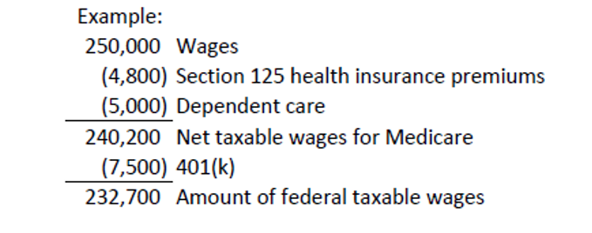
Taxable Wages – Federal
Gross wages less pension-401(k) plan amounts, section 125 cafeteria plan items
Box 1 of Form W-2

Slide 15
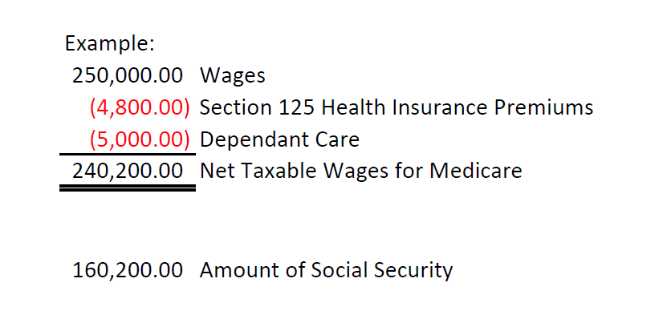
Taxable Wages – Social Security
6.2% is withheld on the first $160,200 of wages for social security in 2023
Section 125 plan items are not subject to social security tax, income tax, and unemployment tax.
Box 3 of Form W-2, tips box 7

Slide 16
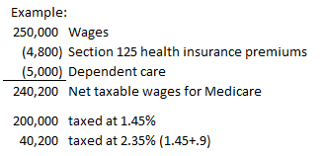
Taxable Wages - Medicare
1.45% is withheld for Medicare, no limit
Additional 0.9% is withheld from employee for wages over $200,000
Box 5 of Form W-2

Slide 17
Form W-2, Box 12 Codes
Code DD only required if 250 or more Forms W-2

Slide 18
Supplemental Wages
Supplemental wages are wage payments to an employee that aren’t regular wages.
They include, but are not limited to:
Bonuses
Commissions
Payments for accumulated sick leave
Severance pay
Awards
Prizes
Back pay
Retroactive pay increases
Taxable fringe benefits
Expense allowances paid under a non-accountable plan
Payments for nondeductible moving expenses

Slide 19
Federal Withholding on Supplemental Wages
Supplemental wages combined with regular wages
If you pay supplemental wages with regular wages but don’t specify the amount of each, withhold federal income tax like a normal pay period
Supplemental wages identified separately from regular wages
If you pay supplemental wages separately (or combine them in a single payment and specify the amount of each)
If income tax was withheld from an employee’s regular wages in the current or immediately preceding calendar year:
Withhold at a flat 22%
Withhold like a normal pay period
Employee receives more than $1 million of supplemental wages during the calendar year- withhold at 37% without regard to the employee’s W-4, on the amount over $1 million.

Slide 20
Minnesota Withholding on Supplemental Wages
Follows federal guidelines
If you pay supplemental wages and list them together on your payroll records
Withhold like a normal pay period
If you pay supplemental wages and list them separately on your payroll records
Withhold like a normal pay period or
Withhold like a normal pay period for regular wages and withhold 6.25% on the supplemental wages
If you pay supplemental wages separately from regular wages
Withhold 6.25% on the supplemental wages regardless of withholding allowances

Slide 21
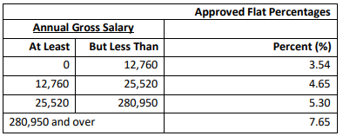
Wisconsin Withholdings on Supplemental Wages
If paid with regular wages, withhold as if supplemental wages were one
If paid between regular payroll periods, determine the tax by adding the supplemental wages to the current payroll period or last preceding payroll period within the same calendar year
Flat percentages (on supplemental wages only)

Slide 22
401(k), 403(b), Simple IRAs
On W-2, pre-tax for Federal and State only; not deducted from Social Security, social security tips or Medicare
401(k) Roth Contributions are after-tax contributions
Note – 401(k) and Roth 401(k) combined total may not go over the max allowed
Notes:
https://www.irs.gov/retirement-plans/401k-resource-guide; check the retirement box

Slide 23
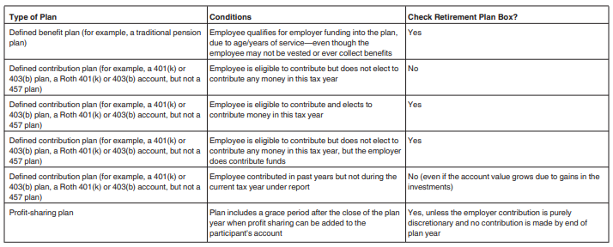
Form W-2, Box 13 Retirement Plan
To check the box or not to check the box?

Slide 24
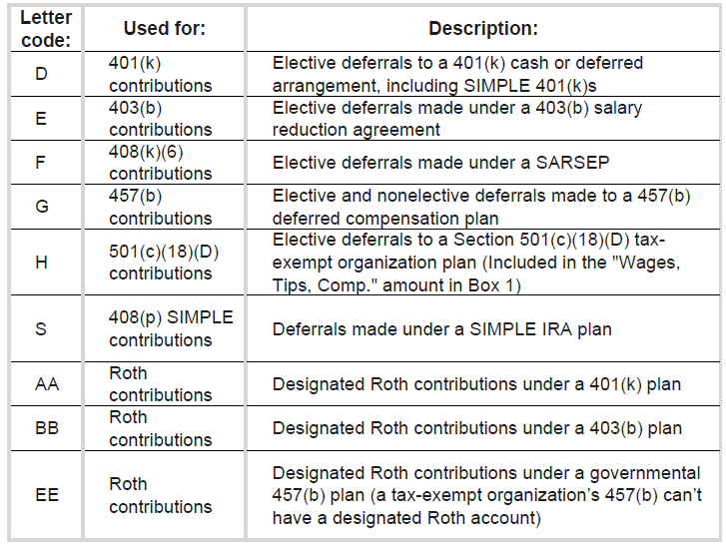
Box 12 Codes for Retirement Plans

Slide 25
Reconciliation Spreadsheet

Slide 26
Qualified Sick and Family Leave Wages
Form 941
Qualified sick leave wages and qualified family leave wages paid during a quarter of 2023 for leave taken after 3/31/20 and before 4/1/21 are reported on lines 5a(i) and 5a(ii).
Qualified sick leave wages and qualified family leave wages paid during a quarter of 2023 for leave taken after 3/31/21 and before 10/1/21 are reported on line 5a(i) and 5a(ii).

Slide 27
Pre-Tax Benefits

Slide 28
Tax-Favored Health Plans
Health Savings Account (HSA)
Benefits:
Contributions are Pre-Tax
Permitted to take distribution at any time; only qualified medical expenses can be reported as nontaxable.
Interest/earnings are tax free
Portable
Can carry forward
Qualifications:
Must be covered under a high deductible health plan (HDHP)
2023 - $3,850 single; $7,750 family
2024 - $4,150 single; $8,300 family
Additional contribution of $1,000 if 55 or older
Cannot have other health coverage except what is permitted
Aren’t enrolled in Medicare
Cannot be claimed as a dependent on someone else’s tax return
Partners and 2% or greater shareholders of an S corporation are not eligible for salary reduction (pre-tax) contribution to an HSA
HSA contributions of a 2% S-Corp shareholders should be noted in Box 14 of the W-2 along with the amount of health insurance paid.
Notes:
HSA – a Trustee is a bank, insurance company; does not need to be thru your employer; can claim deduction on your 1040
Earnings on HSA are tax free; HSA is portable; any eligible individual can contribute, also employee and employer

Slide 29
Medical Savings Account (MSA)
Benefits:
Claim a tax deduction on your 1040 for your contributions (Form 8853); only qualified medical expenses are deductible
Interest/earnings are tax free
Portable
Can carry forward
Qualifications:
Employee of a small employer (50 or fewer employees during either of the last 2 calendar years)
Self-employed person, self-only or family HDHP
Cannot have health or Medicare coverage
Annual limit of 75% of the annual deductible of HDHP; 65% for self-only plan
Employee, employer, self-employed can make contributions; employer and employee cannot make contribution in the same year

Slide 30
Health Reimbursement Arrangements (HRA)
Funded solely by an employer
Employees reimbursed tax free for qualified medical expenses
No limit on amount of money your employer can contribute
Can be carried over to following year
Qualified Small Employer HRA
Fewer than 50 full-time or equivalent employees
2023 limit $5,850 individual – $11,800 family
2024 limit $6,150 individual - $12,450 family
Flexible Spending Arrangements (FSA)
Medical Care Reimbursements (Health FSA)
Dependent Care Assistance
Adoption Assistance

Slide 31
Health FSA
Funded through voluntary salary deduction (pre-tax); employer can also contribute if specified in the plan
Max contribution of $3,050/year
Benefits:
Employee reimbursed for medical expenses
Employer contributions excluded from gross income
Qualifications
Employer-established
Self-employed are not eligible
Employer may match up to $500 to FSA; starting at $501, employers can only make dollar-for-dollar match
Employer may utilize Carryover or Grace Period option under special rule for health or dependent care FSA:
Carryover option
Employee may be able to carry over $610 in 2023 of unused funds to the following plan year
Grace Period option
Employee has 2 ½ months after end of plan year to incur eligible expenses
Special Covid-19 relief that gave employers the option to allow employees to carry over their unspent 2021 balance into 2022, has not been extended into 2023.
Notes:
https://www.shrm.org/ResourcesAndTools/hr-topics/benefits/pages/irs-2022-hsa-contribution-limits.aspx
https://www.shrm.org/ResourcesAndTools/hr-topics/benefits/Pages/irs-benefits-contributions-limits-chart-2022.aspx

Slide 32
Dependent Care FSA
Pretax used to pay for day care, preschool, summer camps and non-employer sponsored before and after school programs. No overnight camps.
Expenses relating to children under 13 or special need individuals
Cannot discriminate
Limit for 2023 is $5,000
Adoption Assistance FSA
Pretax used to pay for “necessary and reasonable expenses” relating to adopting a child. Phases out based on income
Cannot be used to adopt their spouse’s child
2023 max $15,950
2024 max $16,810

Slide 33
Health Insurance Premiums on 2% Shareholders
Health insurance premiums paid to employers who are 2% or greater shareholders of an S Corporation are considered wages
Subject to federal income tax withholding
Exempt from Social Security, Medicare and FUTA
Health insurance provided solely to 2% or more shareholder-employees of an S Corporation, NOT to other employees, does not qualify for the FICA exemption and is taxable for Social Security, Medicare and FUTA. Take as a distribution.
HSA’s - Partnerships and S Corporations
Partners and 2% or greater shareholders of an S corporation are not eligible for pretax contributions to an HSA. Employer contributions are treated as distributions or guaranteed payments.

Slide 34
Third Party Sick Pay
Fully taxable if employer paid or employee paid for policy with pre-tax dollars
Nontaxable if employee paid for policy with after-tax dollars
Partially taxable if cost was split, need to prorate
If insurer is not preparing a W-2, benefits must be added to wages
Record a manual check
Reported in Boxes 1,3,5 & 16 on W-2 and check Box 13 – Third-Party Sick Pay
Check the Third-Party Sick Pay box on the W-3
Insurer may need to complete Form 8922, Third-Party Sick Pay Recap

Slide 36
Fringe Benefits

Slide 37
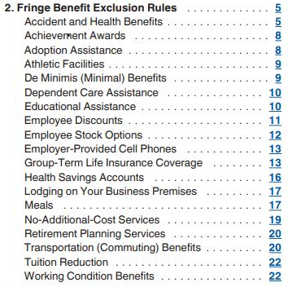
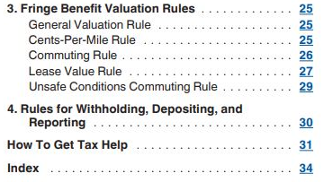
Fringe Benefits – Publication 15-B
Notes:
There are a lot of fringe benefits – make sure you are recording them for payroll purposes; Not going to go through them all, just common ones

Slide 38
Fringe Benefits
IRS regulation section 1.61-1
Gross income means all income from whatever source derived, unless excluded by law. Gross income includes income realized in any form, whether in money, property, or services. Income may be realized, therefore, in the form of services, meals, accommodations, stock or other property as well as cash
Special Accounting Rule (optional)
The employer may elect to treat the value of taxable noncash fringe benefits provided in November and December, or any other shorter period during that time, as paid in the subsequent year. This applies only to the benefits actually provided during November and December, not to benefits that were provided earlier in the year but are treated as being paid during those months. The special accounting rule is limited to noncash fringe benefits.
Notes:
Going to go through most used fringes

Slide 39
Employer Provided Vehicles
Personal use is commuting to/from work, trips not related to work, used on vacation, used by someone other than employee
Personal use of vehicle is subject to federal, Social Security and Medicare taxes. Also subject to FUTA tax.
Reported on W-2 box 1, 3, 5, 16 and 14 (other)
Employee must substantiate (track) mileage between business and personal usage
Or full use of vehicle can be included in the employee’s income by using 1 of 4 valuation methods

Slide 40
- Valuation Methods
General Valuation Method
Cost the employee would incur to lease the same vehicle in the same geographic area and in the same period the automobile is available to the employee.
Special Valuation Method
Commuting valuation
Cents-Per-Mile valuation
Annual lease valuation

Slide 41
- General Valuation Rule
The value the employee would have to pay a third party in an arm’s-length transaction to buy or lease the vehicle in the geographic area where the employee uses the vehicle.

Slide 42
- Commuting Rule
Employer can value PUA (personal use auto) at $1.50 for each one-way commute ($3 round trip).
Can use this method if the following conditions are met:
Employer owned vehicle is provided to employee for company business and de minimis personal use (such as a stop for a personal errand on the way between a business delivery and the employee’s home).
Employer must have written policy prohibiting employee from personal use other than commuting and de minimis personal use
Employee doesn’t use vehicle for personal purposes other than commuting and de minimis personal use.
Employee is not a control employee, director, elected officer with wages of $130,000 or more, an employee with wages of $265,000 or more, owns 1% or more equity, capital or profits interest in the business
Can switch to the lease value rule on the first day which you don’t use the commuting rule

Slide 43
- Cents per Mile
Cannot use if the vehicles value when it is made available to employees is more than $60,800.
FMV for personal use is determined by using standard mileage rate of $0.655 per mile in 2023, this includes the costs of maintenance, insurance and fuel. If you don’t provide fuel to your employees, you can reduce the rate by $0.055 per mile.
2024 standard mileage rate not yet published
To use this rule, one of the following conditions must be met:
You expect the employee to regularly use the vehicle for business throughout the year.
At least 50% of the total mileage each year must be for business.
OR
The vehicle is generally used each workday to transport at least three employees to and from work, in an employer-sponsored commuting pool.
The mileage test is met.
The vehicle is driven by employees at least 10,000 miles per year (business and personal combined)
The vehicle is primarily used by employees

Slide 44
- Cents per Mile (continued)
Consistency requirement:
You must begin using the cents-per-mile rule on the first day you make the vehicle available to any employee for personal use *
You must use the cents-per-mile rule for all later years in which you make the vehicle available to any employee and the vehicle qualifies *
You must continue to use the cents-per-mile rule if you provide a replacement vehicle to the employee (and the vehicle qualifies for the use of this rule) and your primary reason for the replacement is to reduce federal taxes
* See publication 15-B for issues related to commuting rule
Items included in cents-per-mile: maintenance and insurance
You can switch to the lease value rule on the first day the automobile no longer qualifies for the cents-per-mile rule

Slide 45
- Annual Lease Valuation
FMV is determined by multiplying the annual lease value of the car by the percentage of personal miles driven.
Determine FMV of vehicle as of the first day it was made available to any employee for personal use.
The FMV of an automobile is the amount a person would pay to buy it from a third party in an arm's-length transaction in the area in which the automobile is bought or leased. That amount includes all purchase expenses, such as sales tax and title fees
Use the IRS Annual Lease Value Table
Calculate percentage of personal miles driven.
Multiply the annual lease value by the % of personal miles
Personal miles/total miles = % of personal miles driven
If you provide the fuel, you must add $.055 per mile

Slide 46
- Annual Lease Valuation (continued)
Consistency requirements:
You must begin using this rule on the first day you make the automobile available to any employee for personal use *
You must use this rule for all later years in which you make the automobile available to any employee *
You must continue to use this rule if you provide a replacement automobile to the employee and your primary reason for the replacement is to reduce federal taxes
* See publication 15-B for issues related to commuting rule
Items included in the annual lease value table include the value of maintenance and insurance. It does NOT include the value of fuel you provide/pay for. You must include the value of the fuel separately in the employee’s wages either at FMV or at 5.5 cents per mile.
Any use of a company-provided vehicle that isn’t substantiated as business use is included in income

Slide 47
IRS Annual Lease Value Table
Automobile Fair Automobile Fair
Market Value Annual Lease Value Market Value Annual Lease Value
$ 0 – 999 $ 600 22,000 – 22,999 $ 6,100
1,000 – 1,999 850 23,000 – 23,999 6,350
2,000 – 2,999 1,100 24,000 – 24,999 6,600
3,000 – 3,999 1,350 25,000 – 25,999 6,850
4,000 – 4,999 1,600 26,000 – 27,999 7,250
5,000 – 5,999 1,850 28,000 – 29,999 7,750
6,000 – 6,999 2,100 30,000 – 31,999 8,520
7,000 – 7,999 2,350 32,000 – 33,999 8,750
8,000 – 8,999 2,600 34,000 – 35,999 9,250
9,000 – 9,999 2,850 36,000 – 37,999 9,750
10,000 – 10,999 3,100 38,000 – 39,999 10,250
11,000 – 11,999 3,350 40,000 – 41,999 10,750
12,000 – 12,999 3,600 42,000 – 43,999 11,250
13,000 – 13,999 3,850 44,000 – 45,999 11,750
14,000 – 14,999 4,100 46,000 – 47,999 12,250
15,000 – 15,999 4,350 48,000 – 49,999 12,750
16,000 – 16,999 4,600 50,000 – 51,999 13,250
17,000 – 17,999 4,850 52,000 – 53,999 13,750
18,000 – 18,999 5,100 54,000 – 25,999 14,250
19,000 – 19,999 5,350 56,000 – 57,999 14,750
20, 000 – 20,999 5,600 58,000 – 59,999 15,250
21,000 – 21,999 5,850 For Vehicles having a fair market value in excess of $59,999, the annual lease value
= (0.25 x the auto’s fair market value) + $500
https://www.irs.gov/pub/irs-pdf/p15b.pdf

Slide 48
Example of Personal Use of Auto Calculation

Slide 49
Group Term Life Insurance
Non-taxable for the first $50,000 of coverage if:
Provides a general death benefit that is not includable in income
Provided to a group of employees of more than 10 (even if not all employees choose the benefit); see Pub. 15-B for exceptions
Provides an amount of insurance to each employee based on a formula that prevents individual selection
Provided under a policy that the employer either directly or indirectly carries.
Amount over $50,000 (reduced by any employee after-tax payroll deductions) is taxable income
Taxable for Social Security and Medicare
Taxable for Federal Withholding but employer does not have to withhold
Non-taxable for FUTA & SUTA

Slide 50
Group Term Life Insurance (continued)
W-2, Box 12 with the Code C
Prorate the cost if less than a full month of coverage
2% or greater S-Corp shareholders – all included in wages
Non-taxable to employee when:
The beneficiary of the policy is the company for the entire calendar year
The beneficiary of the policy is a charitable organization for the entire calendar year
The employee terminates during the year due to a permanent disability

Slide 51
Group Term Life Insurance (continued)
Calculating Excess GTL
Determine excess over $50,000 (to the nearest $100)
Divide excess by $1,000
Determine employees’ age as of 12/31
Multiply rate found in IRS Publication 15-B (next slide) by amount in Step 3
Deduct any after-tax employee contributions
Additional rules for:
Spouse-Dependent Group Term Life
Former Employees Group Term Life
See Publication 15-B

Slide 52
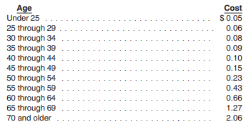
Group Term Life Table
Cost per $1,000 of protection per 1 month

Slide 53
Group Term Life Calculation

Slide 54
Moving Expenses
Effective in 1/1/18 (and before 12/31/25), moving expenses are no longer a tax-free perk from employers and as an above-the-line deduction.
Members of armed forces on active duty who moves because of a permanent change of station are excluded as long as the employee did not get reimbursed https://www.irs.gov/forms-pubs/about-publication-3

Slide 55
Education Assistance
Certain job-related education you provide to an employee may qualify for exclusion as a working condition benefit. The education must meet at least one of the following tests:
The education is required by the employer or by law for the employee to keep his or her present salary, status or job. The required education must serve a bona fide business purpose of the employer
The education maintains or improves skills needed in the job
However, even if the education tests are met, it isn’t qualifying education if:
It is needed to meet the minimum educational requirements of the employee’s present trade or business
Is part of a program of study that will qualify the employee for a new trade or business
If you receive educational assistance benefits from your employer under an educational assistance program, you can exclude up to $5,250 of those benefits each year.

Slide 56
Business Travel, Meals & Entertainment, Gifts, Transportation
Under an accountable plan, allowances or reimbursements paid to employees for job-related expenses are excluded from wages and not subject to withholding. An allowance or reimbursement policy (not necessarily a written plan) is considered an accountable plan if:
There is a business connection to the expenditure
Expenses incurred while performing services as an employee
There is adequate accounting by the recipient within a reasonable period of time
Bills, receipts, cancelled checks or similar items to support the expense
Excess reimbursements or advances are returned within a reasonable period of time
The determination of the length of a reasonable period of time will depend on the facts and circumstances
A nonaccountable plan is an allowance or reimbursement that does not meet all three requirements above.
The payment, reimbursement, etc. of these expenses are taxable wages subject to all withholding
An expense that is lavish or extravagant is not allowed

Slide 57
Business Travel
The IRS announced special per diem rates that can be used to substantiate the amount of business expenses incurred for travel away from home on or after 10/1/23 thru 9/30/2024.
Employers using these rate to set per diem allowances can create certain categories of travel expenses as substantiated without requiring that employees prove the actual amount they spent (the employee should still substantiate the time, place and business purpose of their travel expense)
Prior to 10/1/22: Per-Diem allowance for traveling each day is non-taxable
Allowance amount is deemed substantiated as long as it does not exceed IRS-established federal per-diem rates – if exceeds these rates, overage is taxable
Federal per-diem rate is a combination of the federal lodging expense rate and the meal and incidental expense rate (M&IE) for the locality of travel in the continental US
See https://www.gsa.gov/travel/plan-book/per-diem-rates for rates
Mileage reimbursement is non-taxable up to the federal standard mileage rate as long as it is substantiated. Any reimbursement over the federal rate is taxable. An employer is allowed to pay under the federal rate
Mileage rate for 2023 is $0.655 per mile. (2024 rate is not yet available)

Slide 58
Loans to Employees
If loan made at interest rate below the applicable federal rate (AFR), the difference is taxable on any day that the outstanding loans are more than $10,000
Taxable amount is subject to SS, Med, FUTA, SUTA and also included in box 1 of Form W-2
The AFR can be found at: https://apps.irs.gov/app/picklist/list/federalRates.html
Loans under $10,000
No imputed interest unless the principal purpose of the loan is tax avoidance
No imputed interest on loans for relocations to a new principal place of work
No imputed interest on advances repaid within a reasonable period of time
Proper documentation of the loan is important
The employer’s cancellation of an employee loan results in cancellation of indebtedness income rather than compensation. The canceled loan should be reported on IRS Form 1099-C
Notes:
https://answerconnect.cch.com/contents-document/d7fa5d467dde1000b600000d3a8daaf40a/1-04-loans-to-employees?searchId=814084172&disableHighlight=false

Slide 59
Prizes and Awards
Awards and prizes are generally included as income with certain exceptions:
Achievement-Safety Awards
Given to an employee for length of service, employee achievement or safety achievement
Award is tangible personal property (not cash or cash equivalent, stocks, vacations, meals, lodging, or tickets)
Award is given in a meaningful presentation
Award is not disguised as compensation
Length of service award is excluded from income if:
The employee receives the award after their first 5 years of employment but not more frequently than every five years.
The employee didn’t receive another length-of-service during the same year or in any of the prior 4 years
Limit of $400 for awards under a nonqualified plan
Limit of $1,600 for all awards in a calendar year, whether or not qualified

Slide 60
Back Pay and Legal Awards
Back-pay awarded to a taxpayer constitutes wages and is reportable on Form W-2 in the year paid
Awards for punitive damages, nonphysical injury or sickness, discrimination or defamation is considered income but are reported in Box 3 of Form 1099-MISC (see instructions for 1099-Misc for more information)

Slide 61
Jury Duty Pay
Any pay by employer above and beyond payment from the courts is taxable
If employer requires employee to turn over jury pay, only the difference between amount paid and turned over is taxable

Slide 62
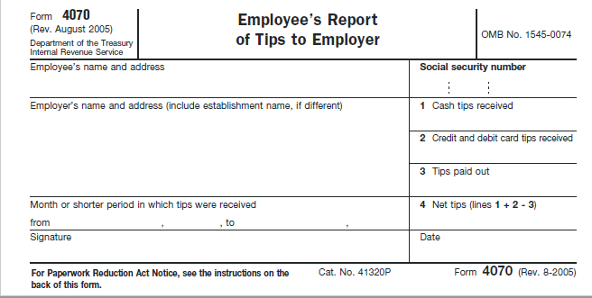
Tips
Taxable income (does not include allocated tips which are reported in box 8 of W-2)
Earnings of $20 a month in tips must be reported by employee to employer by the 10th of the next month (or more often if employer requires)
Reported on Form 4070 or similar statement
Service charges are not tips but are wages; these charges are added to a customer’s check without the customer having a right to determine the “tip line”.
Some examples are:
Large dining party automatic gratuity
Banquet event fee
Cruise ship package fee
Bottle service charge
Hotel room service charge

Slide 63
Gift Cards
Always taxable
Has a specific value
Not unreasonable or administratively impractical to account for (IRC Section 132)
Employer-Provided Cell Phones
Provided for non-compensatory business reasons is not a fringe benefit for business reasons:
The employer needs to contact the employee at all times for work related emergencies
The employer requires the employee to be available to speak with clients at times when the employee is away from the office
The employee needs to speak with clients located in other time zones at times outside the employee’s normal workday

Slide 64
Adding Fringe Benefits to Pay
If fringe benefits are entered with a regular payroll, taxes are calculated so it may not be necessary to gross up
Federal and State income tax withholding is not required
If fringe benefits are entered after the final payroll of the year, it will need to be grossed up for Social Security and Medicare
Social Security Gross Up – Below SS limit
Current Social Security rate is 6.2% and Medicare rate is 1.45%; total FICA rate is 7.65%; Subtract the total rate from 100 = 92.35%
Divide the desired net pay by 92.35%
Social Security Gross Up – Over SS limit
Medicare rate is 1.45% (or 2.35% if over $200,000). Subtract the total rate from 100 = 98.55% (or if over $200,000 limit 97.65%
Divide the desired net pay by 92.35%
Verify fringe benefits are added to Box 1, 3, 5, and 16 on W-2 and listed in Box 14 – if not, give employee separate sheet to accompany the W-2

Slide 65
De Minimis Fringe Benefits
A de minimis benefit is any property or service provided to an employee that has so little value (taking into account how frequently you provide similar benefits to your employees) that accounting for it would be unreasonable or administratively impracticable. Cash and cash equivalents (gift card, charge card, or credit card) no matter how little, are never excludable as a de minimis benefit, except for the occasional meal money or transportation fare.

Slide 66
Examples of De Minimis Fringe Benefits
Occasional personal use of an employer’s copying machine (no more than 15% of total use)
Occasional group meals, or picnics for employees
Traditional birthday or holiday gifts of property (not cash) with a low fair market value.
Occasional theater or sporting event tickets.
Coffee, doughnuts, and soft drinks.
Local telephone calls.
Flowers, fruit, books, or similar property provided to employees under special circumstances (e.g., on account of illness, outstanding performance, or family crisis).

Slide 67
Independent Contractors

Slide 68
Employee vs. Independent Contractor
Employee
Employer controls
When you work
How you do it
Employer supplies
Tools
Know how
Benefits
Vacation
Personal Time Off
Health Insurance
Retirement Plan
Independent Contractor
Individual has written contract that states
Length of project
What happens in the event project is not completed satisfactorily
No reimbursements for gas or supplies
Pays in his/her own FICA

Slide 69
Federal Tests – Independent Contractors
Common Law Rules – facts that provide evidence of the degree of control and independence fall into 3 categories:
Behavioral – Does the company control or have the right to control what the worker does and how the worker does his or her job?
Financial – Are the business aspects of the worker’s job controlled by the payer? (these include things like how the worker is paid, whether expenses are reimbursed, who provides tools/supplies)
Type of relationship – Are there written contracts or employee type benefits (ex. pension plan, insurance, vacation pay, etc.)? Will the relationship continue and is the work performed a key aspect of the business?
Notes:
https://www.irs.gov/businesses/small-businesses-self-employed/independent-contractor-self-employed-or-employee

Slide 70
WI and MN – Nine Requirements Test – Independent Contractor
Maintain a separate business
Maintain a Federal ID# OR have filed business or self-employment income tax returns with the IRS based on the work or service in the previous year.
A Social Security # cannot be substituted for an EIN and does not meet the legal burden of Section 102.07(8), Wis. Stats.
Operate under specific contracts
Responsible for main expenses
Satisfactory completion of work or services
Receive compensation under a contract, per job, by commission or by competitive bid
Realize a profit or suffer a loss
Recurring business liabilities or obligations
Relationship of business receipts to expenditures
https://dwd.wisconsin.gov/worker_classification/wc/ninepart/
https://www.dli.mn.gov/business/independent-contractor/contractor-registration-nine-factor-test
Notes:
https://dwd.wisconsin.gov/worker-classification/wc/ninepart/

Slide 71
Independent Contractor
Have contractor complete a Form W-9
Request a copy of certificate of insurance for workers’ compensation and general liability
If you pay an independent contractor over $600 in a calendar year, you must issue a 1099-MISC or 1099-NEC (failure to do so will result in penalties)
The penalties are calculated based on when you file the information return. It ranges from $50 per return to $580 per return.
It is a good practice to get this information from all vendors
If the independent contractor fails to furnish their taxpayer ID, you must withhold 24% as backup withholding
Best practices for W-9 – request the form before you make the first payment to the vendor. This ensures completion of the form, which you need as a business owner for tax purposes.
Be sure the required boxes are checked and the taxpayer has signed the form.

Slide 72
Form W-9
https://www.irs.gov/pub/irs-pdf/fw9.pdf

Slide 73
Relief Provisions Section 530 is a relief provision that terminates a taxpayer’s employment tax liability with respect to an individual not treated as an employee if three statutory requirements are met: 1) reporting consistency; 2) substantive consistency; and 3) reasonable basis.

Slide 74
Form 1099-MISC, Miscellaneous
Report payments made in the course of your business or trade; personal payments are not reportable.
$10 or more for royalties
At least $600 (unless otherwise stated) in:
Rents
$10 or more for royalties
Other income
Federal income tax withheld
Fishing boat proceeds
Medical and health care payments
Payer made direct sales totaling $5,000 or more. This can also be reported on form 1099-NEC.
Substitute payments in lieu of dividends or interest
Crop insurance proceeds
Gross proceeds paid to an attorney (settlement agreement)
Fish purchased for resale
Section 409A deferrals
Excess golden parachute payments
Nonqualified deferred compensation
Barter transactions, exchanges of services between individuals in the course of their business.
Cash payments for fish (or other aquatic life) you purchase form anyone engaged in the business of catching fish.
Notes:
Misc – Attorney – Settlement agreement; Prizes and awards received in recognition of past accomplishments in religious, charitable, scientific, artistic, educational, literary, or civic fields are not reportable if: • The winners are chosen without action on their part, • The winners are not expected to perform future services, and • The payer transfers the prize or award to a charitable organization or governmental unit under a designation made by the recipient.

Slide 75
Form 1099-MISC, Miscellaneous
Reportable payments to corporations:
Medical and health care payments – report in box 6
Gross proceeds paid to an attorney – report in box 10
Example: a settlement agreement
Substitute payments in lieu of dividends or tax-exempt interest – report in box 8

Slide 77
Form 1099-NEC, Nonemployee Compensation
Report payments made in the course of your business or trade; personal payments are not reportable
At least $600 in:
Services performed by someone who is not your employee (including parts and materials)
Payments to an attorney for legal services – even if they are a corporation
Payer made direct sales totaling $5,000 or more.
Nonprofit organizations are subject to these reporting requirements
Notes:
Attorneys – includes law form; attorneys fees of $600 or more in the course of your trade or business
Federal exec agency – for federal contracts

Slide 79
Affordable Care Act

Slide 80
Affordable Care Act
Applies to All Applicable Large Employers (ALEs)
ALE’s are US employers having 50 or more full-time employees (or full-time equivalents) in the previous tax year
Companies that are affiliates or are commonly controlled are treated as one employer for the purpose of determining ALE status - these companies must combine their numbers for the full-time employee total
The following persons and entities that provide minimum essential coverage during a calendar year are required to file 1095’s
Health insurance issuers, or carriers, for all insured coverage
Plan sponsors of self-insured group health plan coverage
Executive department or agency of a governmental unit that provides coverage under a government-sponsored program
Any other person that provides minimum essential coverage to an individual
Used to determine:
Whether an employee is eligible for a tax credit if they purchased their health coverage on a Marketplace Exchange
Whether the ALE is subject to a penalty under the employer shared responsibility provisions

Slide 81
Reporting Requirements
Form, 1095-A is issued by the Health Insurance Marketplace
Form 1095-B is issued by health insurance issuers and carriers
Form 1095-C is issued by employer to the employee of an ALE who is full-time or an employee for any month of the calendar year
Why are these forms required?
All large employers (over 50 FTE’s) are required to offer affordable health insurance to their employees. These forms help regulate this requirement.
Employers who fail to comply, fail to comply on time, or fail to properly document their compliance, will face stiff financial penalties
If you need assistance, we are here to help! https://www.hawkinsash.cpa/services/1095-services/
Hawkins Ash provides 1095 services including preparation, filing, and mailing of the forms for any clients in need of this service.

Slide 82
Minnesota Paid Sick & Safe Leave

Slide 83
Minnesota Paid Sick & Safe Leave
Goes into effect January 1, 2024
Who is covered?
All employees (part-time & temporary) working in MN for at least 80 hours in a year.
Become eligible after the first 80 hours.
Earn 1 hour for every 30 hours worked up to a maximum of 48 hours each year
What can it be used for?
The employee’s or a family member’s mental or physical illness, treatment or preventative care.
Absence due to domestic abuse, sexual assault, or stalking of the employee or family member.
Closure of employee’s workplace, childcare, or family member’s school due to weather or public emergency
When determined by a health authority that the employee or a family member is at risk of infecting others with a communicable disease.
Which family members are included?
Please see the list provided on the website: https://www.dli.mn.gov/sick-leave
Note: If the employer already provides PTO, Vacation, or Sick time above or exceeding the 48 hours required to their employees, they would be considered compliant with the statute.
ESST local ordinances are in effect in the cities of Bloomington, Duluth, Minneapolis, and St. Paul MN, and may vary from the requirements under state law. This may mean following some of the requirements of state ESST law and other requirements of the local ESST law.

Slide 84
2026 Minnesota Paid Family and Medical Leave Law
Goes into effect January 1, 2026
Changes are still being made to the new law.
This is separate from the Minnesota Paid Sick & Safe Leave
Here is a link for current information:
https://mn.gov/deed/programs-services/paid-family

Slide 85
Miscellaneous

Slide 86
Check List to Processing First Payroll in 2024
Enter the 2024 State Unemployment rate
Review and enter any changes for the following:
Health Insurance Premiums
Health Savings Account(s)
Pension Plan Contributions
If there are employees who claim exempt from withholding taxes, make sure a new W-4, WT-4 (WI), W-4MN (MN) is completed
Verify if there are any new benefits being offered that should be added
Verify the first payroll calculates correctly by manually calculating payroll taxes

Slide 87
Recordkeeping
Always keep all documentation for your records for 7 years in the event of an audit
https://www.hawkinsash.cpa/tax-document-retention-guidelines-for-small-businesses/
Recommended record retention schedule:
https://www.hawkinsash.cpa/recommended-record-retention-schedule/

Slide 88
